Slide 1
Analog Lab project
By Karun Mathews Manoj (SC19B120)

Slide 2
Circuit explanation
Circuit to control dc motor speed using PWM.
Note: I have modeled the dc motor in lt spice using a 0.35mH inductor and 0.6 ohm resistor in series.

Slide 3
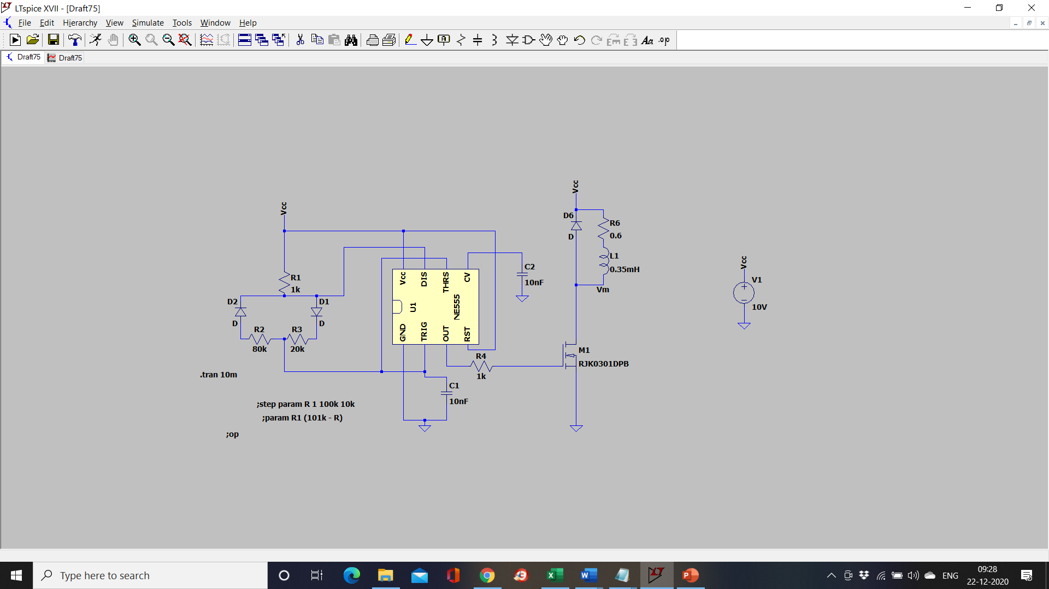
Circuit diagram

Slide 4
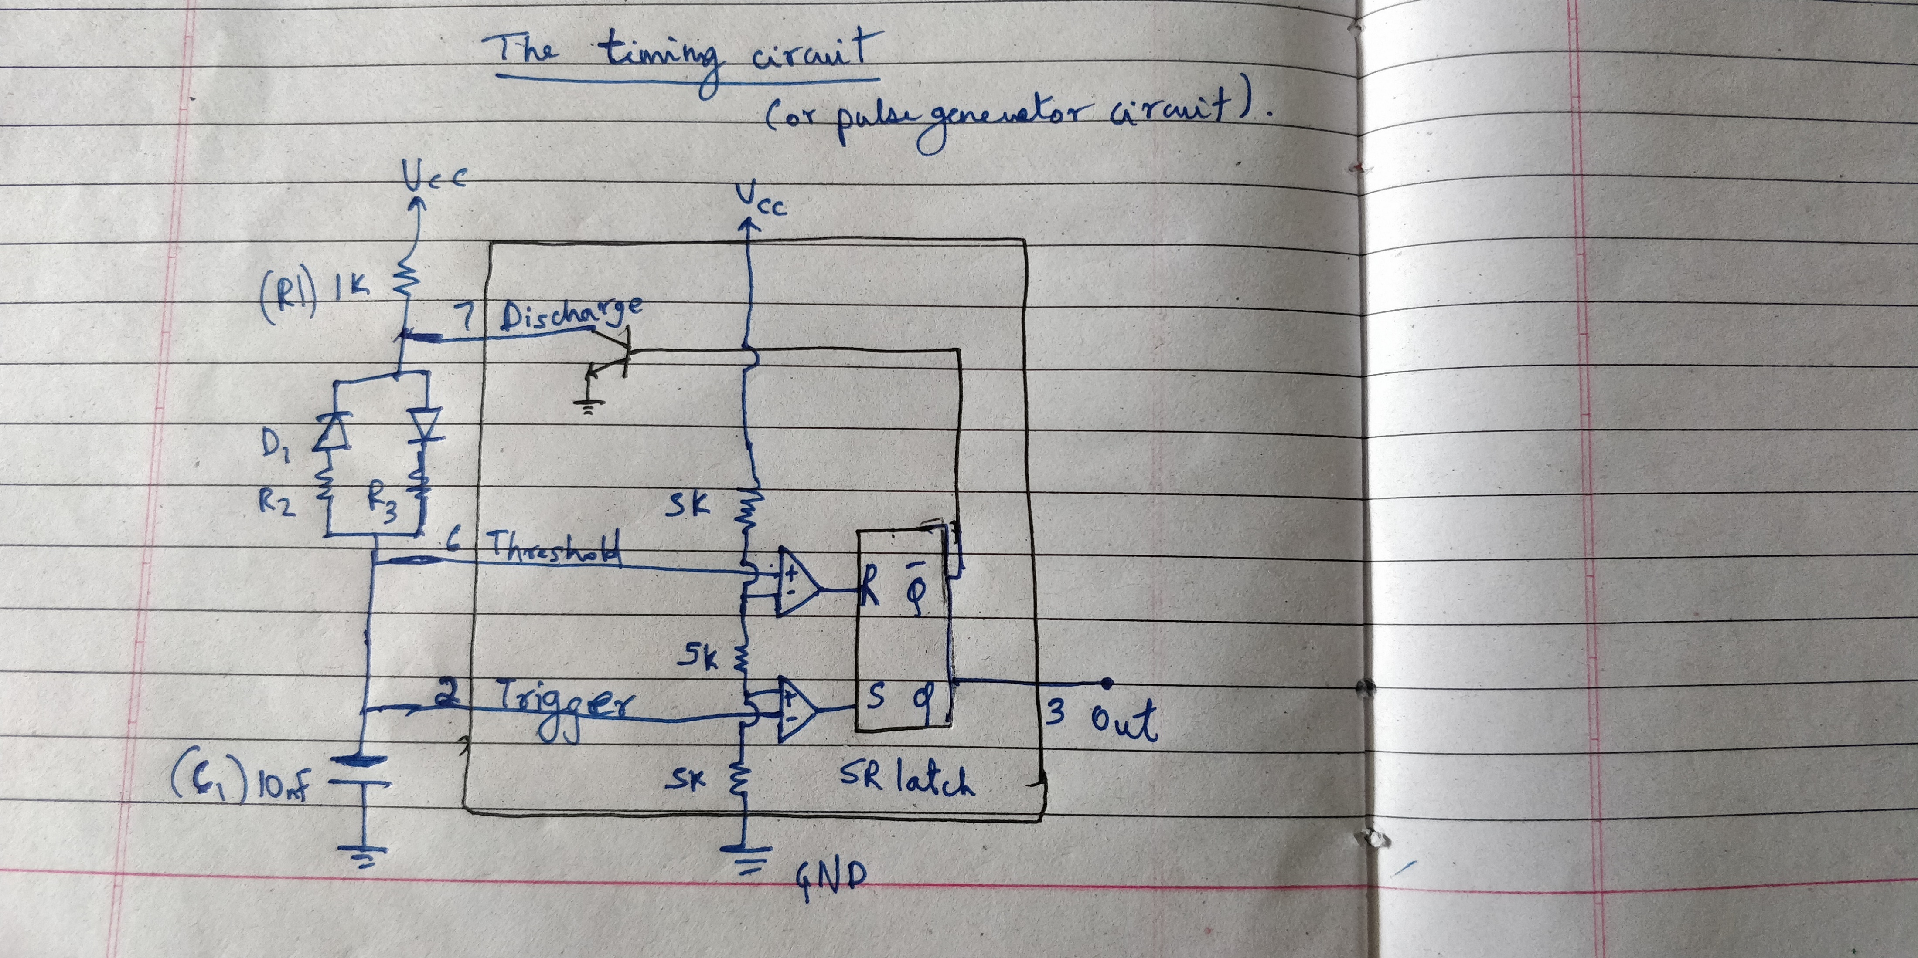
The timing circuit (pulse generator ckt)

Slide 5
How the PWM generator circuit works:
As we can see from the circuit diagram, the charge time depends on the values of R1, R3 and C1.
While the discharge time depends on the values of R2 and C1.
Thus by changing the values of R2 and R3, we can change the Ton and Toff period of the output pulse waveform – and thus the duty cycle of the pulse waveform can be varied.
Charge time, Ton = 0.693*(R1 + R3)*C1
Discharge time, Toff = 0.693*R2*C1

Slide 6
Since the 555 timer cannot handle more than a few mA of current. We use a MOSFET to control the large current, which is required to drive the motor.
By varying the duty cycle of the output pulse waveform, we vary the total current, voltage and power delivered to the dc motor.
Thus we vary the speed of the motor by changing the values of R2 and R3.
In practice using a rheostat would be much easier.

Slide 7
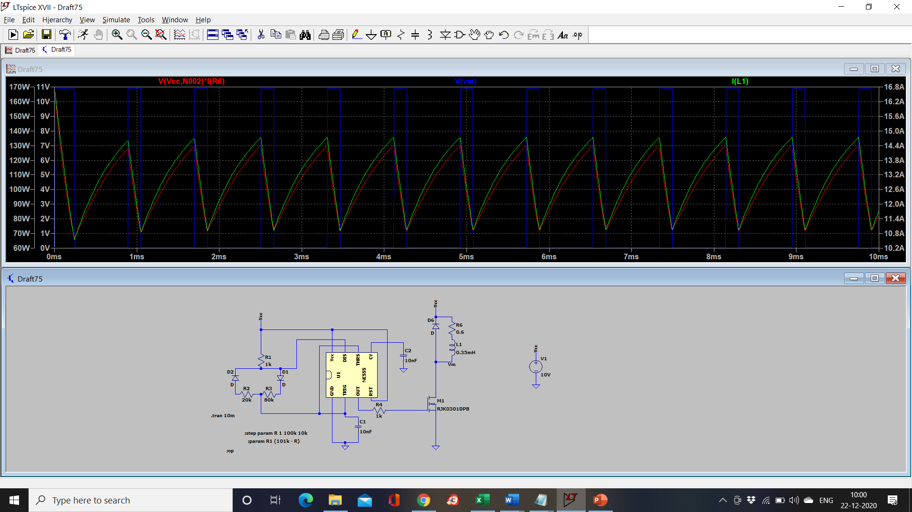

Slide 8
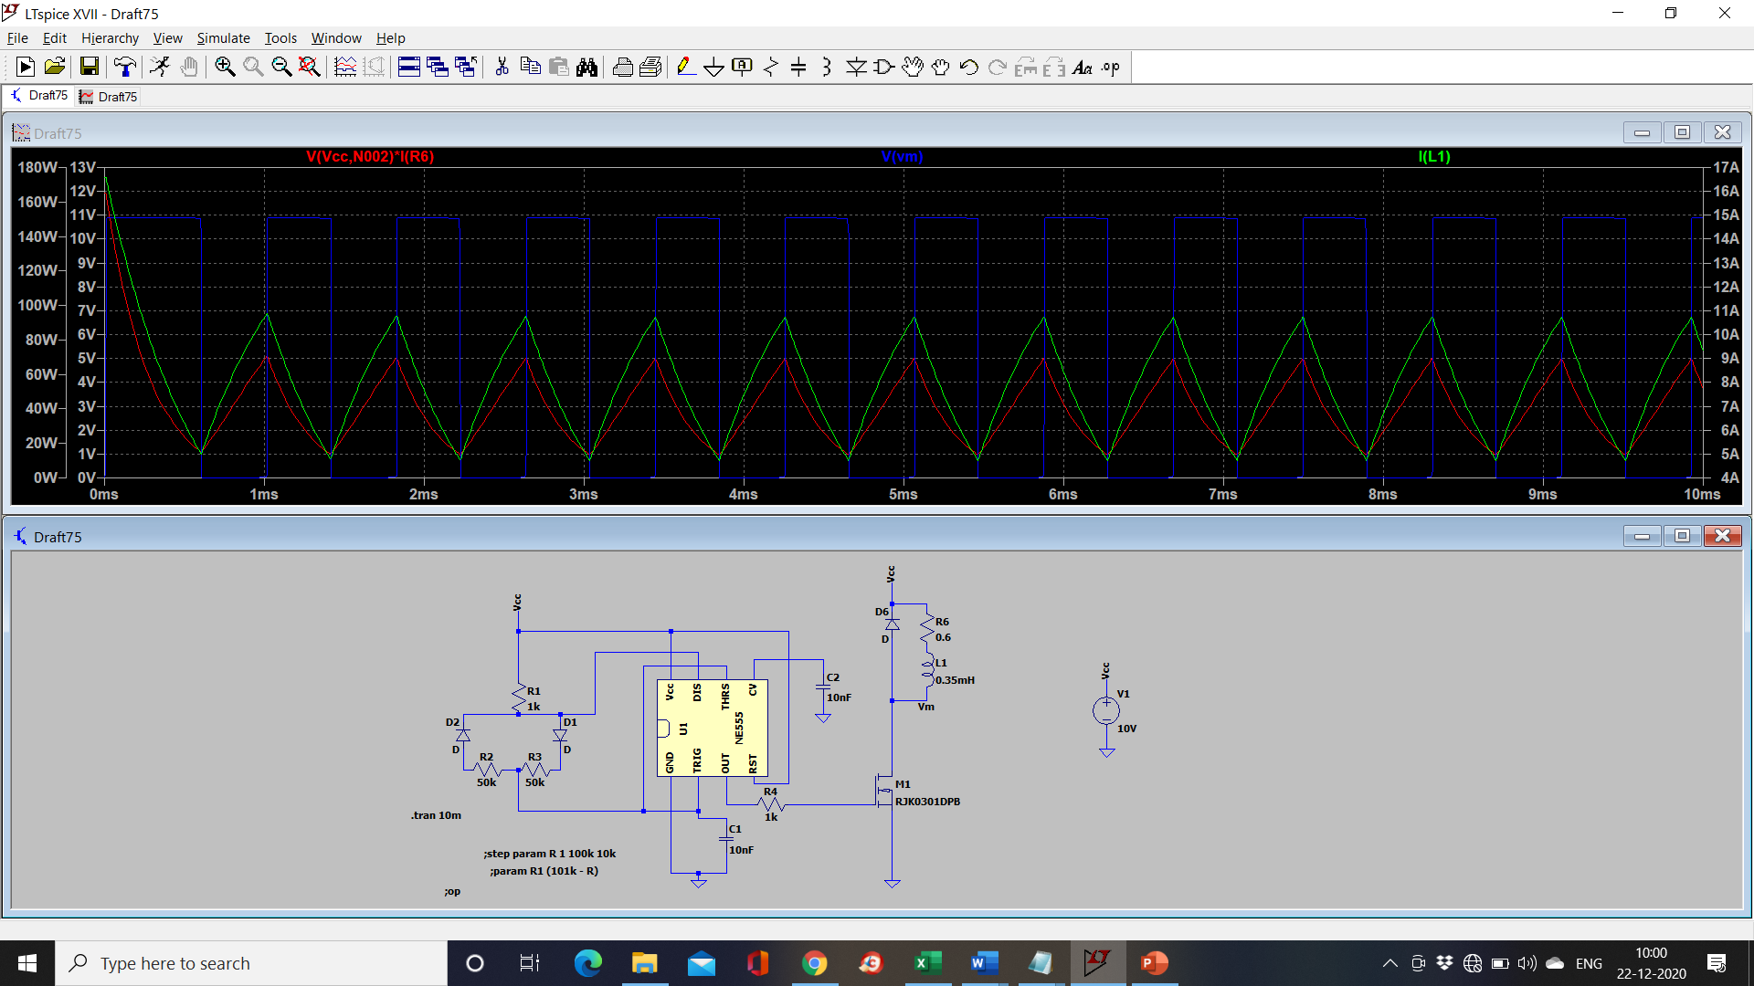

Slide 9
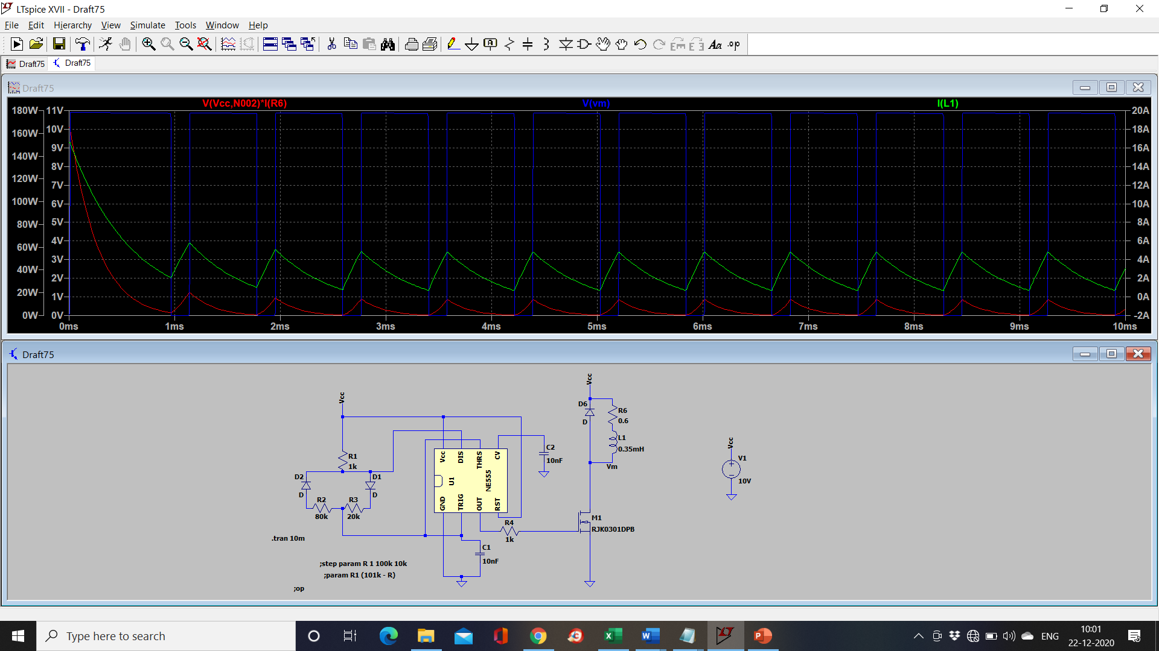

Slide 10
PCB Design for “control of DC motor using ltSpice” :

Slide 11
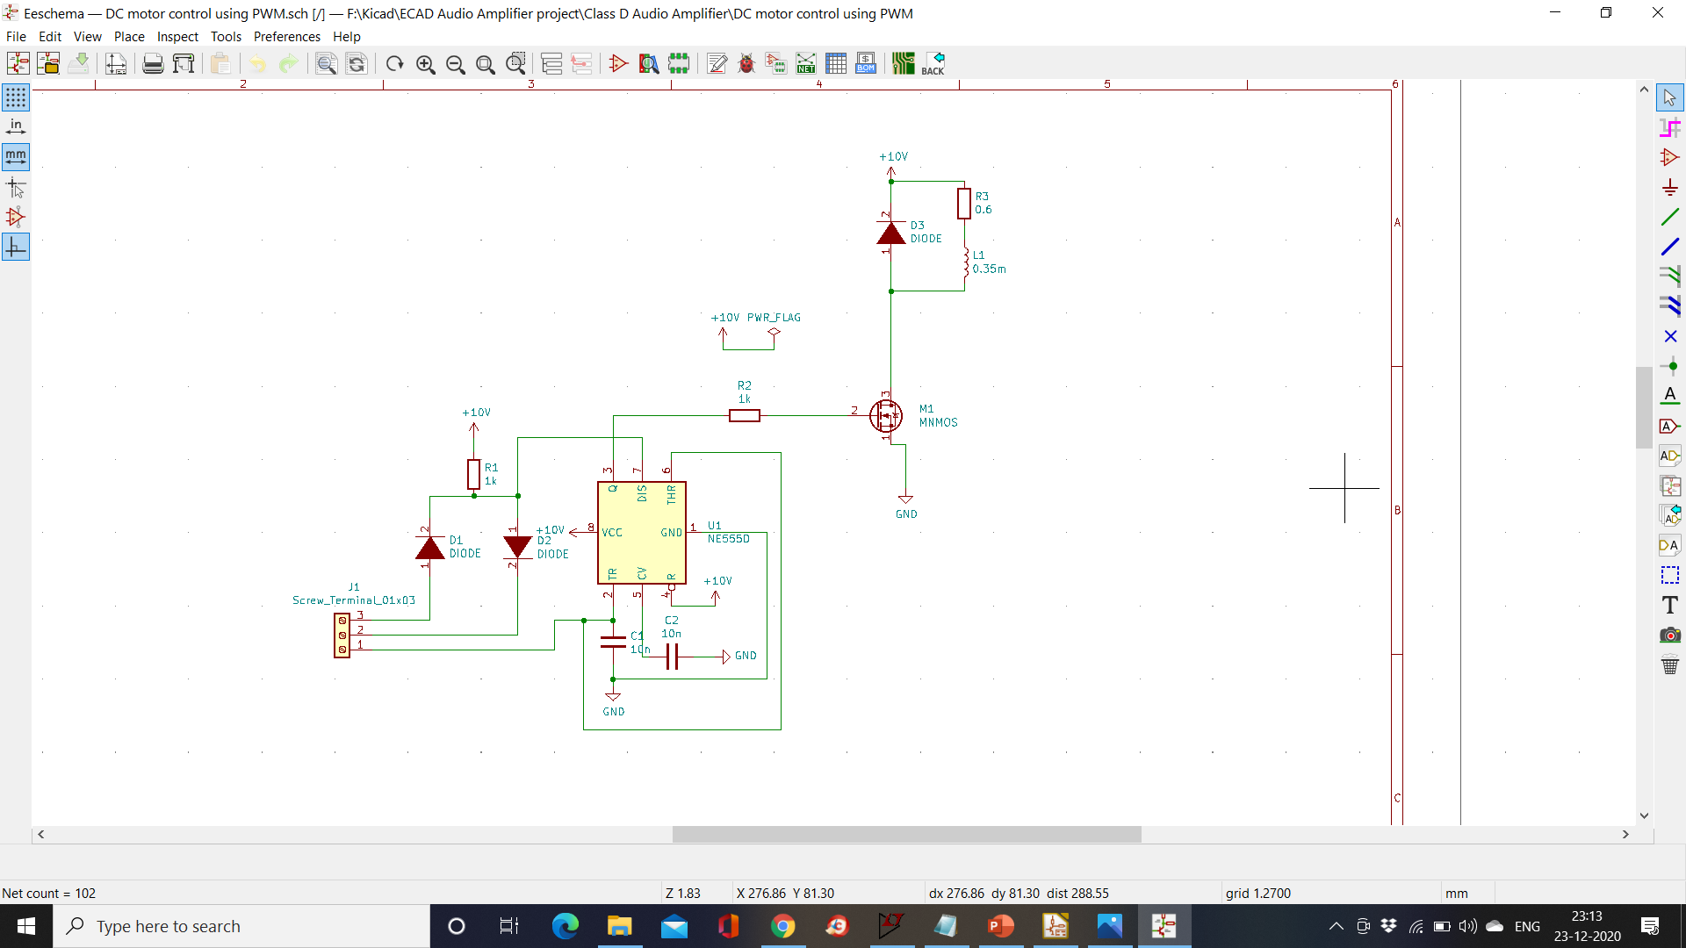

Slide 12
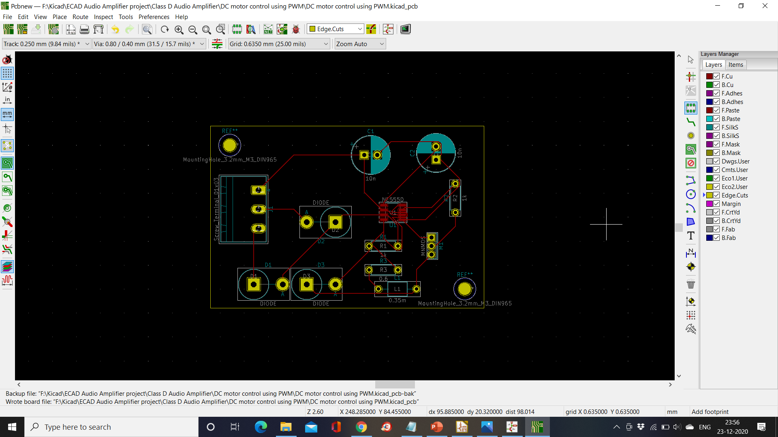

Slide 13
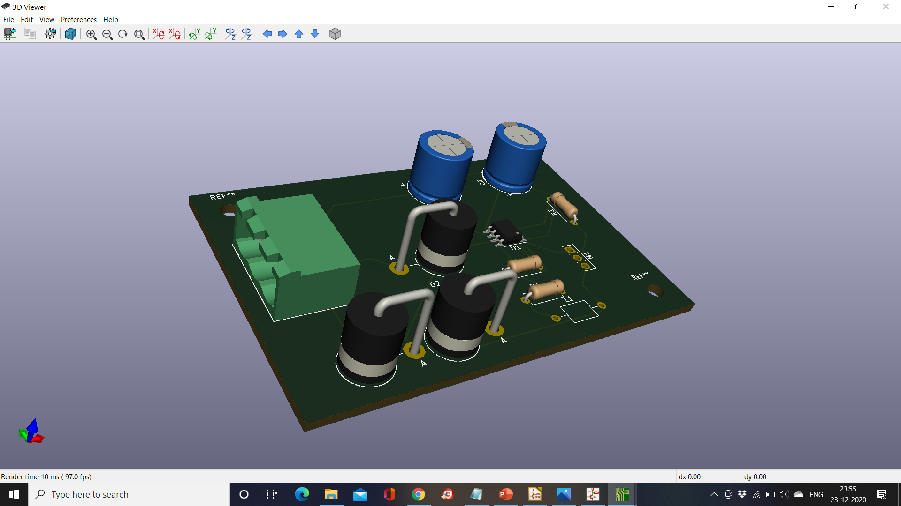

Slide 14
Project presentation
A “video driver” circuit to provide the video input to a Cathode ray tube (CRT) driver circuit.
This circuit takes analog video input (or composite video input) (the same kind seen in TV) and converts it into a form acceptable by the CRT driver circuit.
The CRT driver circuit then feeds this video output into an oscilloscope CRT.
The entire setup is shown on the next page. I only intend to construct the video driver part of the circuit.

Slide 15
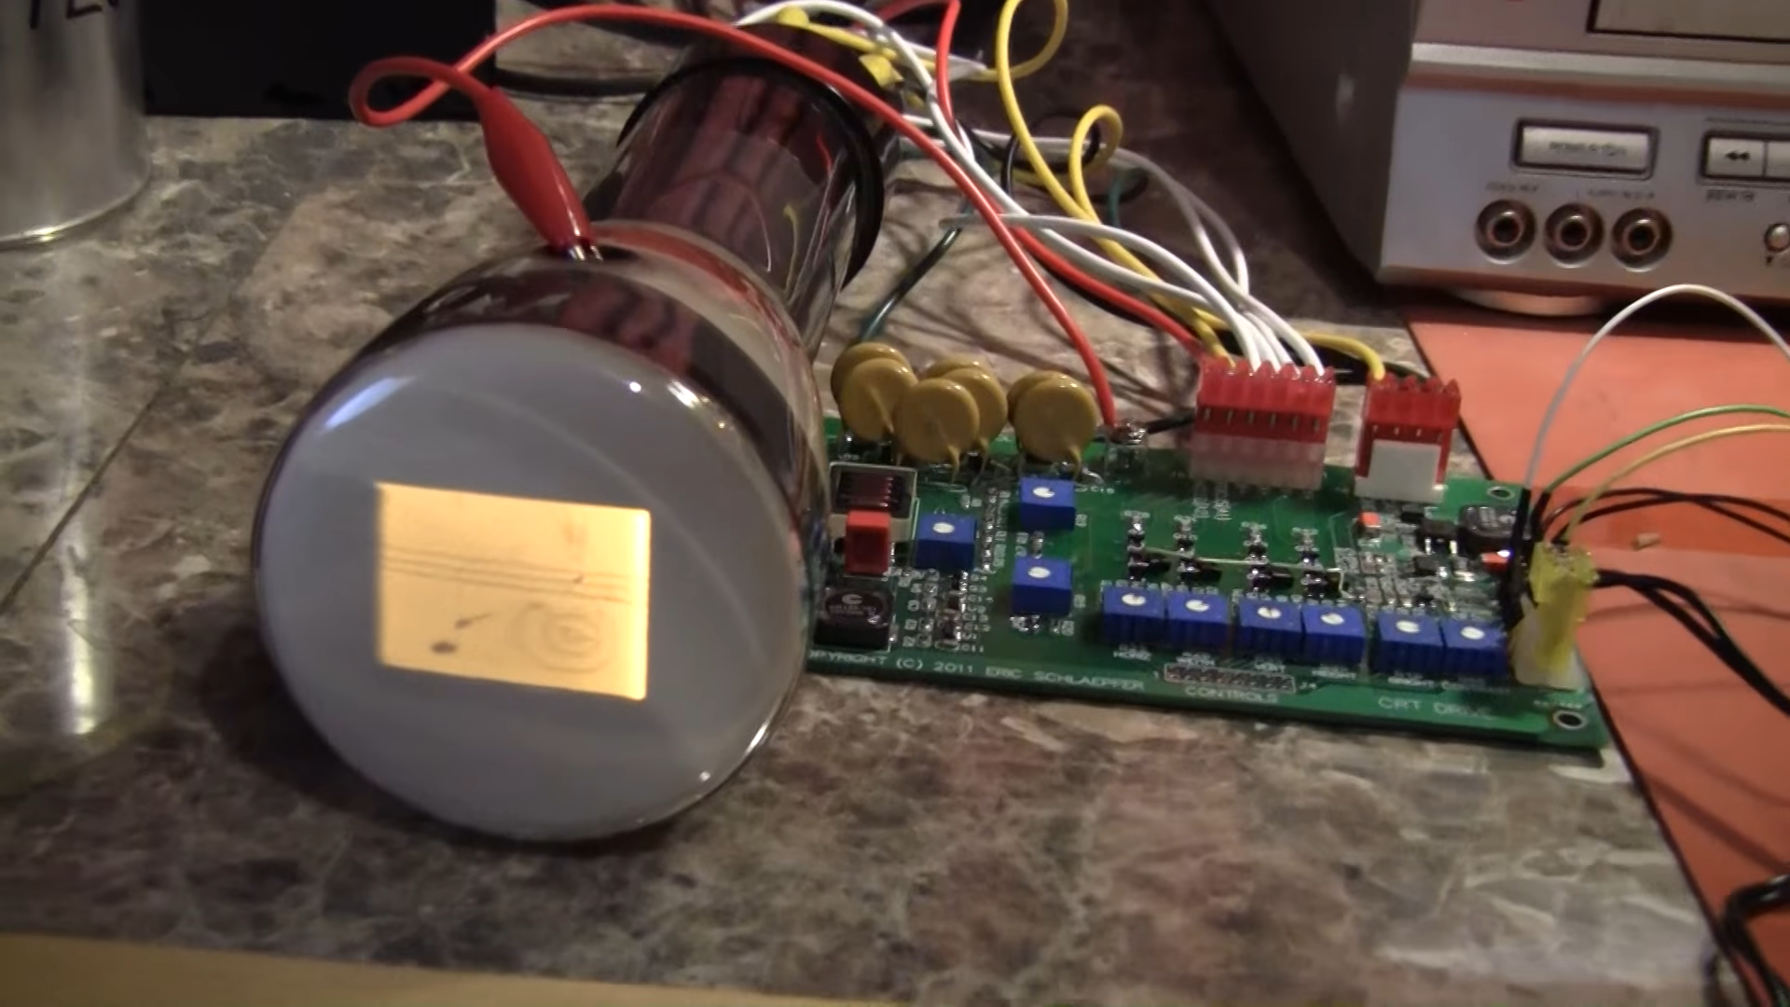

Slide 16
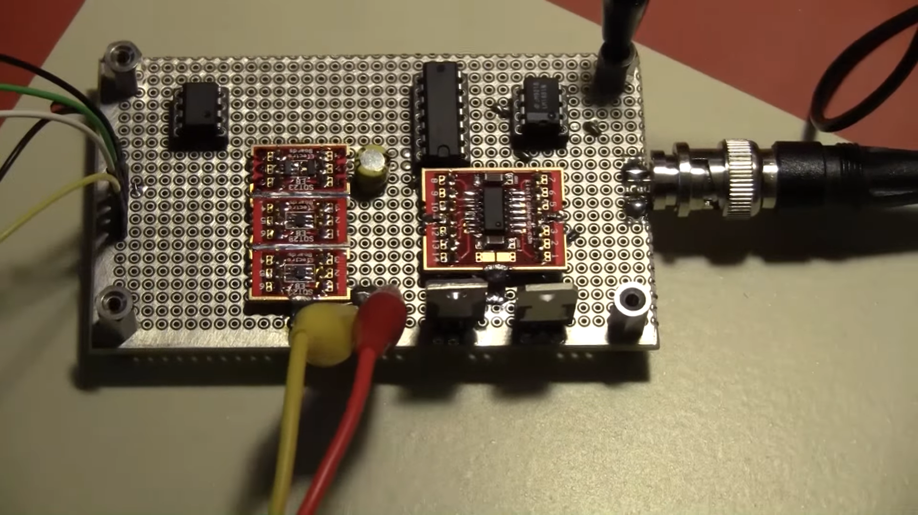

Slide 17
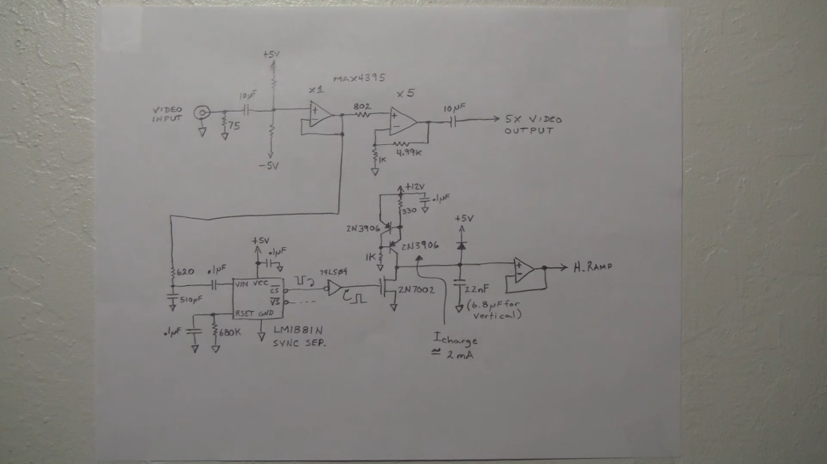
Circuit diagram for the video driver circuit

Slide 18
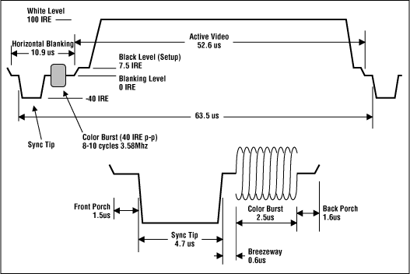
The Composite video signal waveform (NTSC standard)

Slide 19
Different parts of the waveform
- Synchronization signals:
Blanking signal
Horizontal sync pulse
Vertical sync pulse
Equalizing pulses (which are sent along with the vertical sync pulse)
Colour Burst signal (present in each video line – after the horizontal sync signal but during the horizontal blanking period)
This signal gives a reference to the video monitor, as to which colour hue is supposed to be represented and what the colour saturation is.

Slide 20
Circuit explanation
The upper part of the circuit provides the output to the brightness pin of CRT drive circuit. This output is the just the analog video input amplified 5 times.
Horizontal scanning circuit, the capacitor charges in ~50.5 us (which is the length of the active portion of the scan line)
The vertical scanning circuit is driven by the vertical sync pin of the LM1881N sync separator. This circuit is identical to the horizontal scanning circuit, only it uses a different capacitor and takes 262.5 times longer than the horizontal scanning circuit or ~ 16.67 ms .
Both these scanning circuits generate ramp signals (horizontal and vertical), which tell the CRT drive circuit – how long the electron gun in the cathode ray tube must scan a horizontally and vertically.

Slide 21
Circuit explanation (contd.)
The LM1881N is a special IC which extracts the sync signals from the composite video input (as the Vertical sync (VS) and the Composite sync (CS)).
The 620 ohm resistor and 510 pF capacitor act as a simple low pass RC filter circuit, which attenuates the high frequency “colour burst” part of the waveform (which tends to leak into the sync pulse region) and leaves behind the low frequency sync pulses (which is required).
The stacked 2N3906 npn BJTs with the resistors act as a constant current of 2mA, which charges the 22nF capacitor while the 2N7002 MOSFET is switched off.
The diode in series with the 22nF capacitor is present to ensure that the capacitor doesn’t charge up beyond ~5.6V.
The opamp at the right bottom end is a sacrificial part, which protects the circuit from any fluctuations which may enter at the output.
There is also a + – 5V power supply to power the whole circuit.

Slide 22
ltSpice simulations of different parts of the circuit : Note: If we used pwl voltage source we could simulate analog input of the standard NTSC format, but I haven’t found a satisfactory sample, so I just use a simple sinusoid as input.

Slide 23
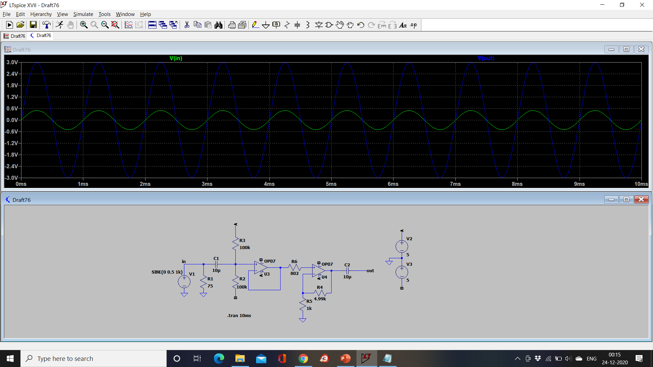

Slide 24
